Slide 1

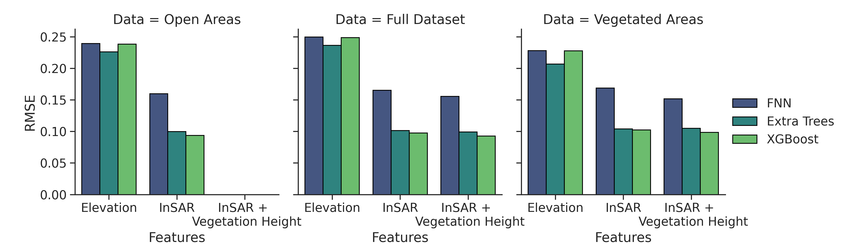
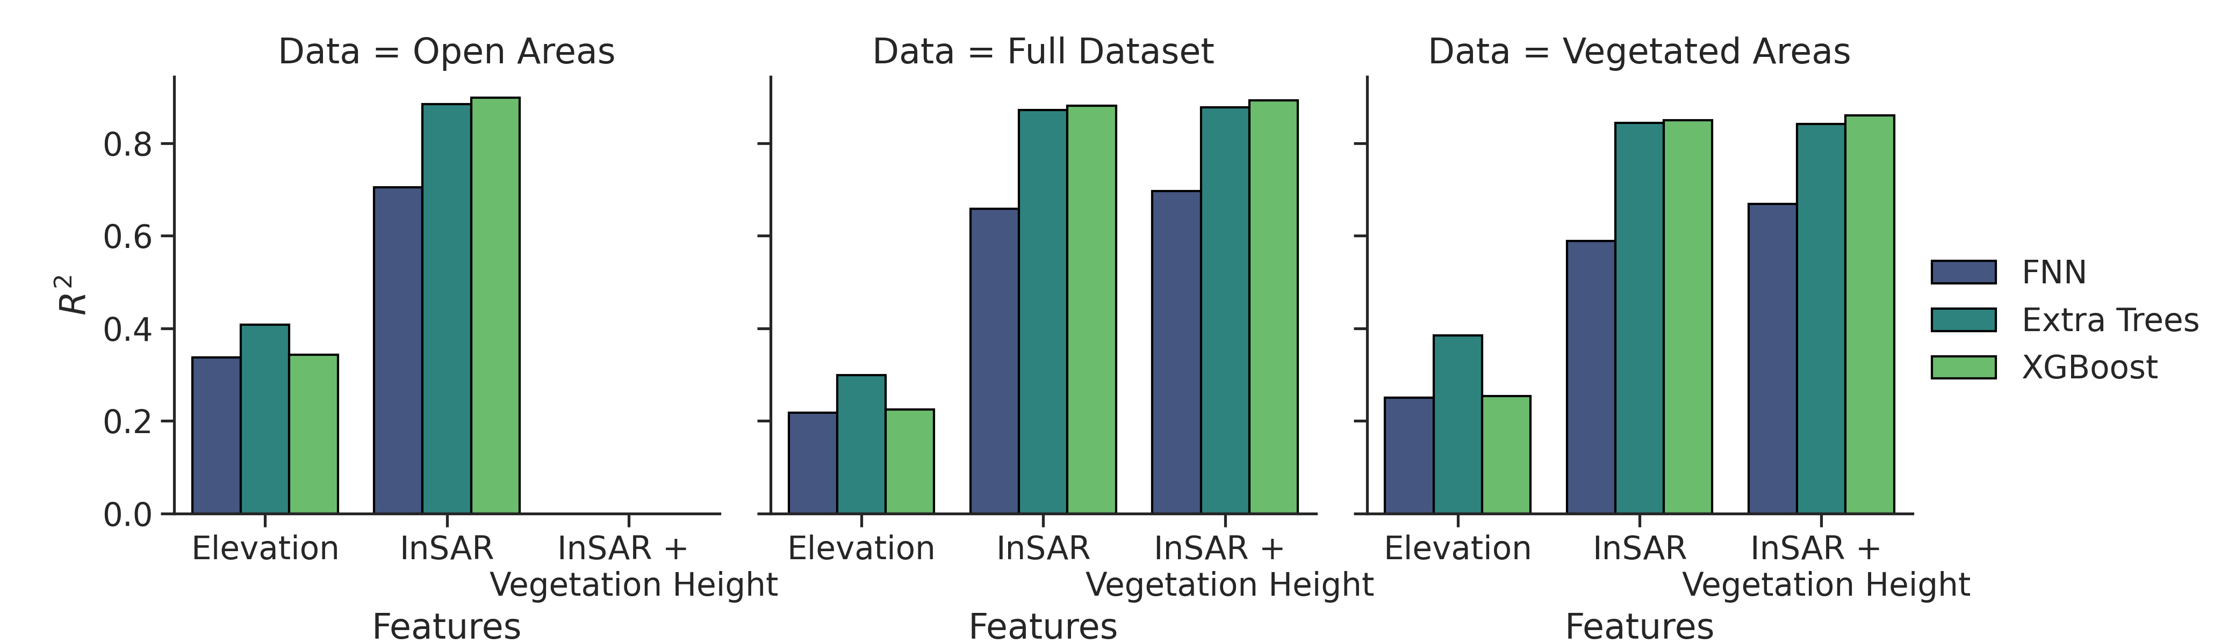
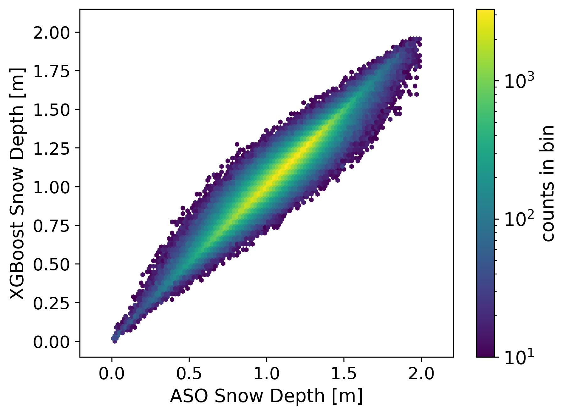
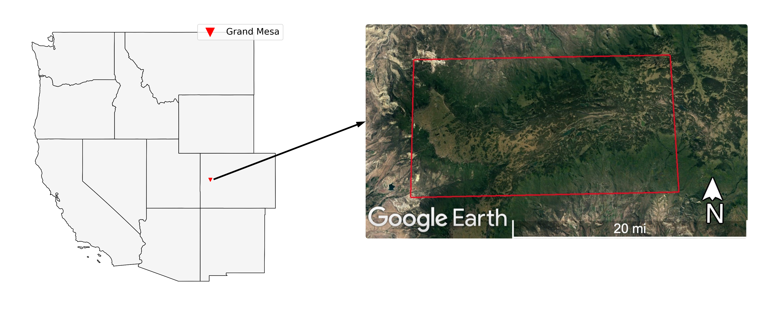
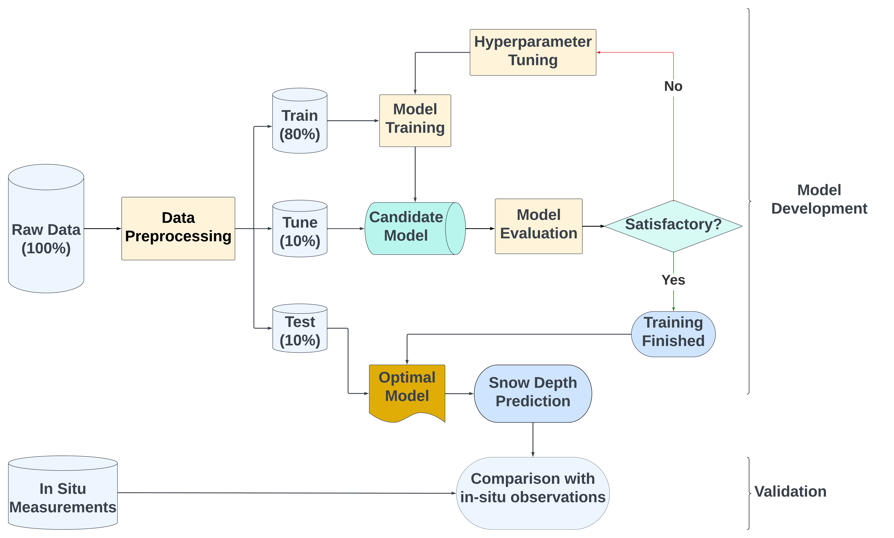
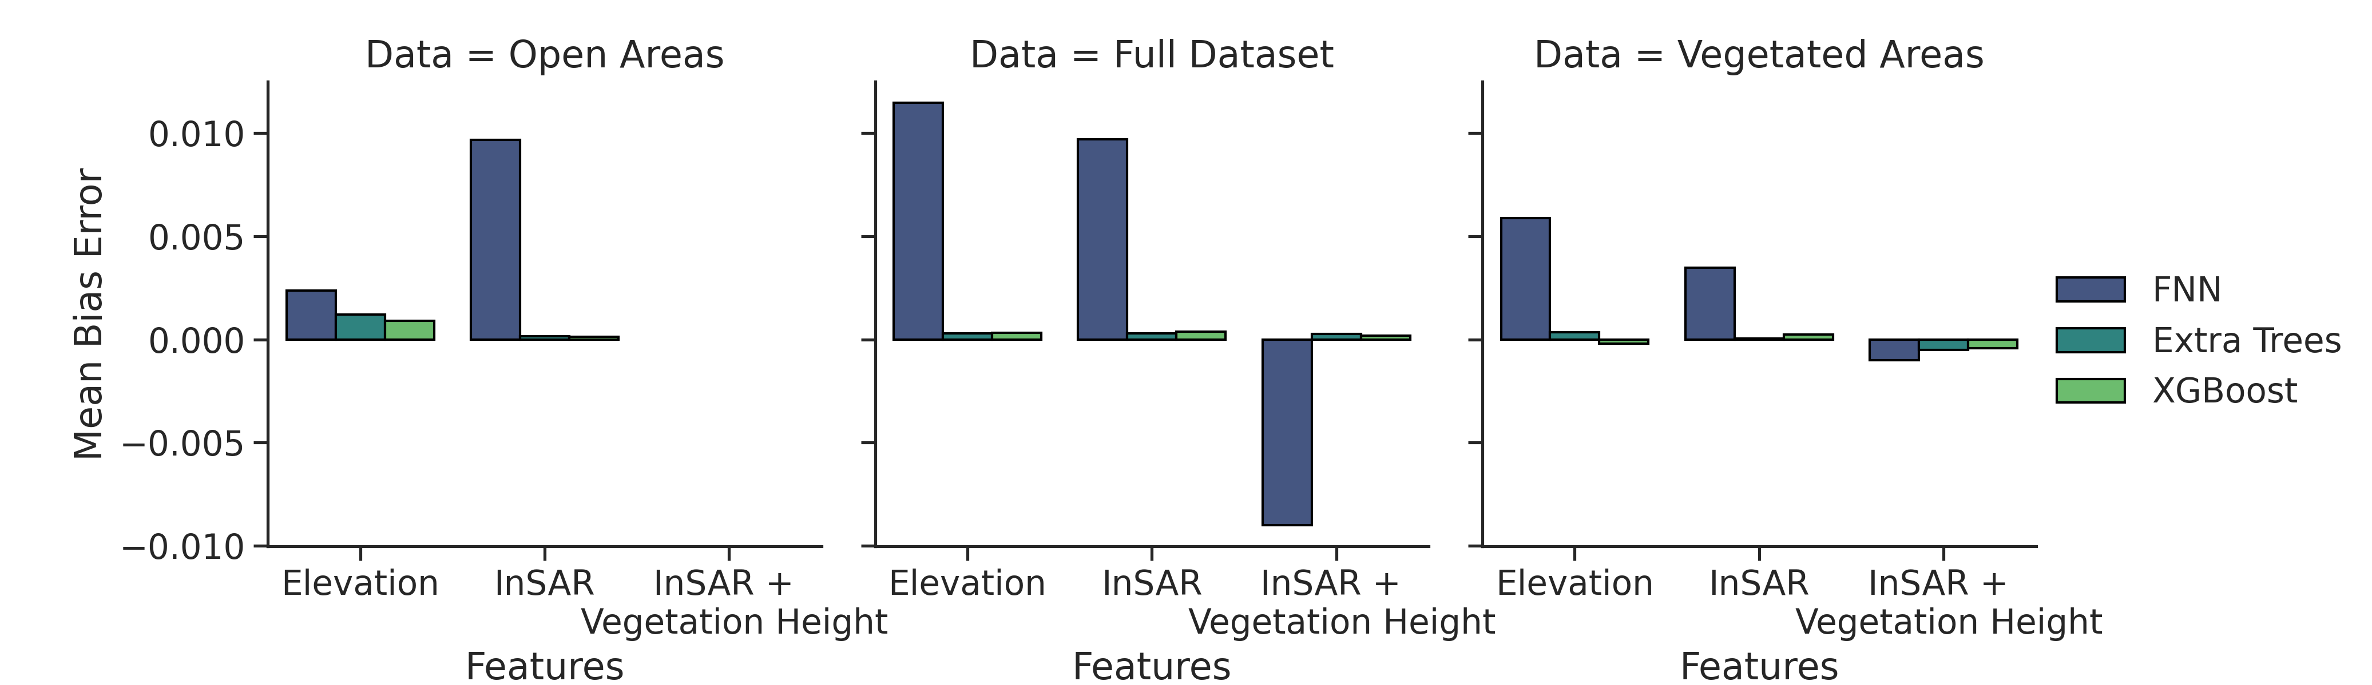
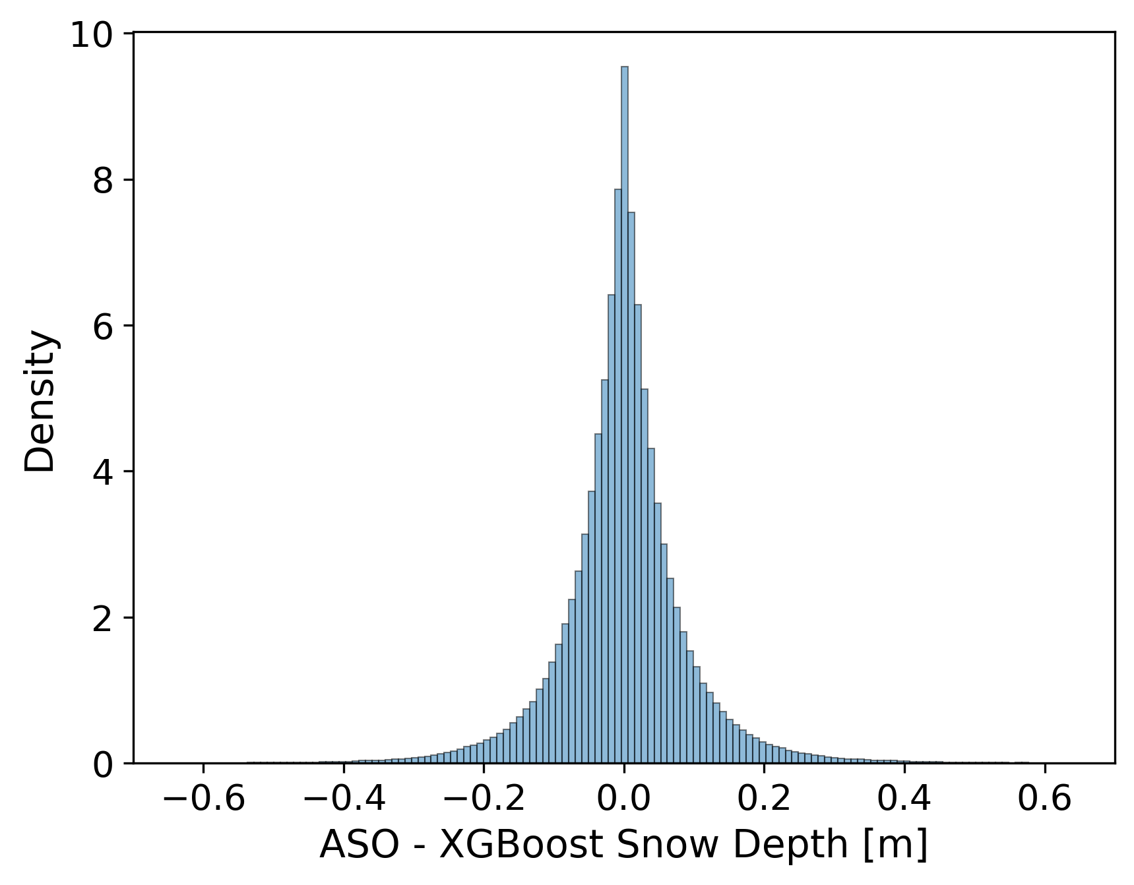
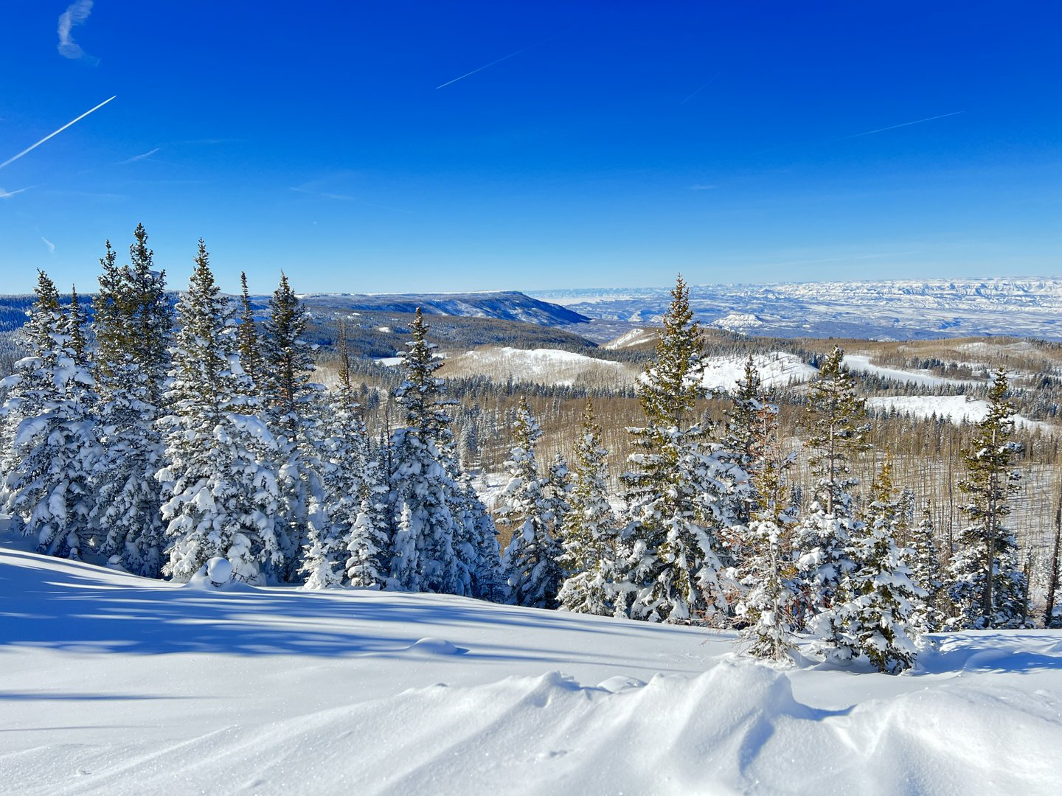
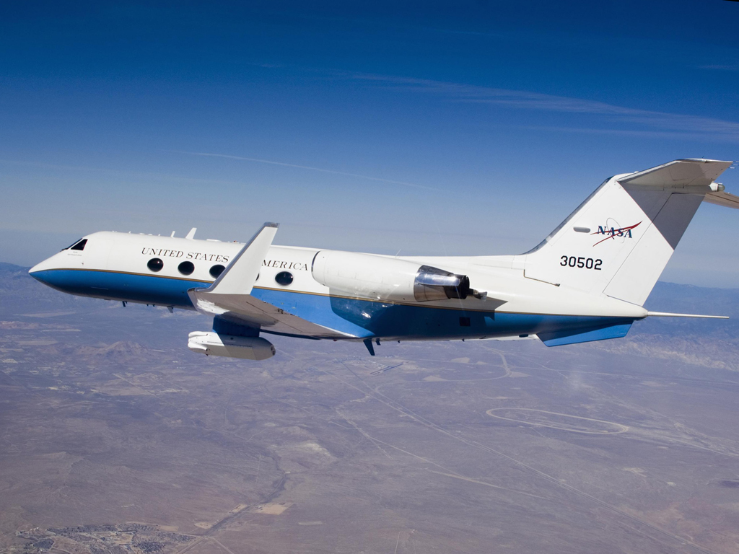
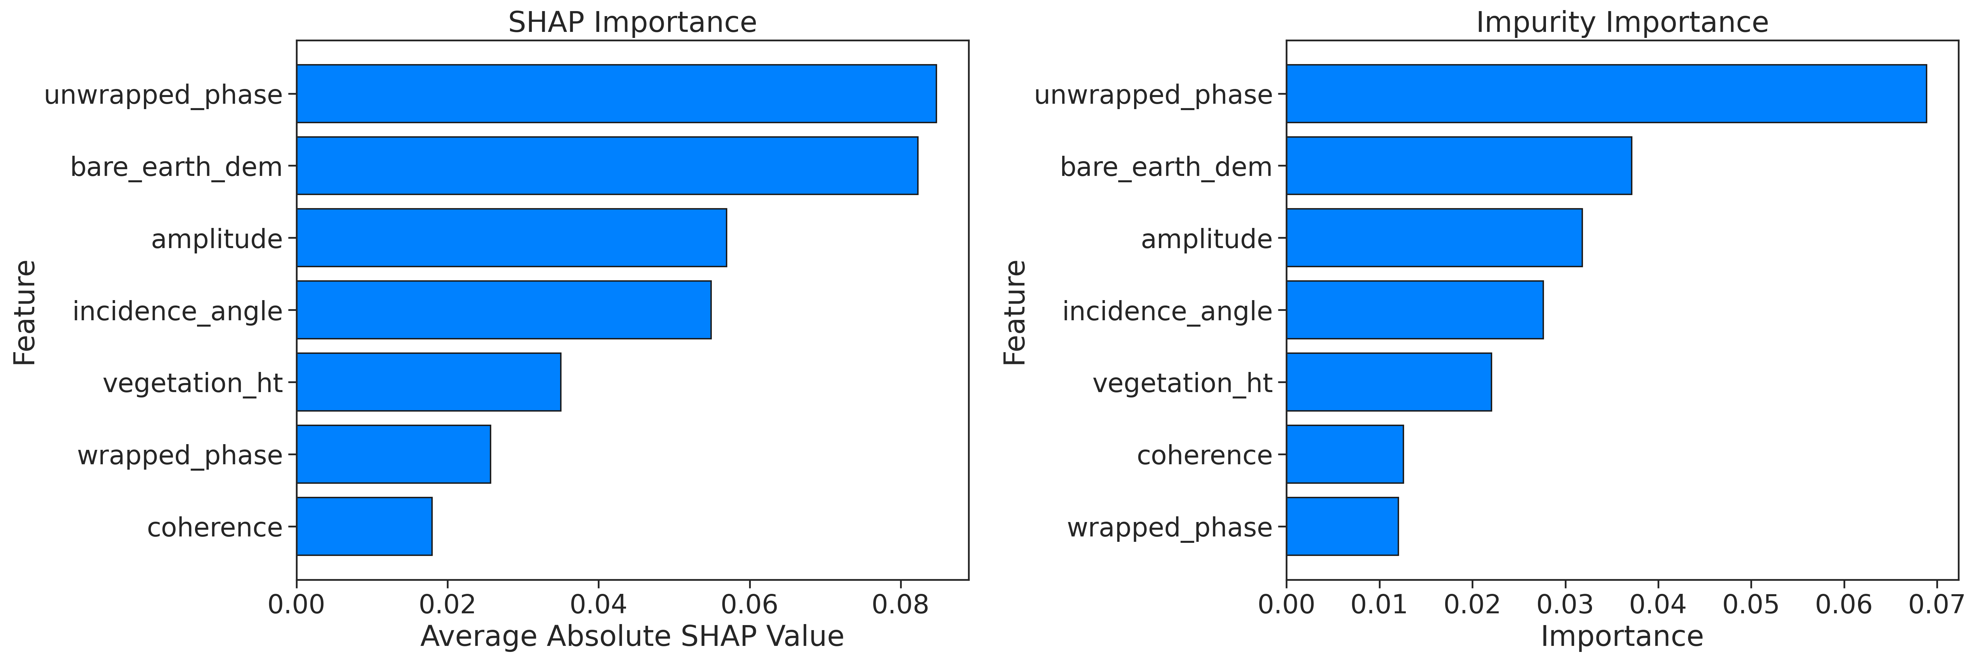
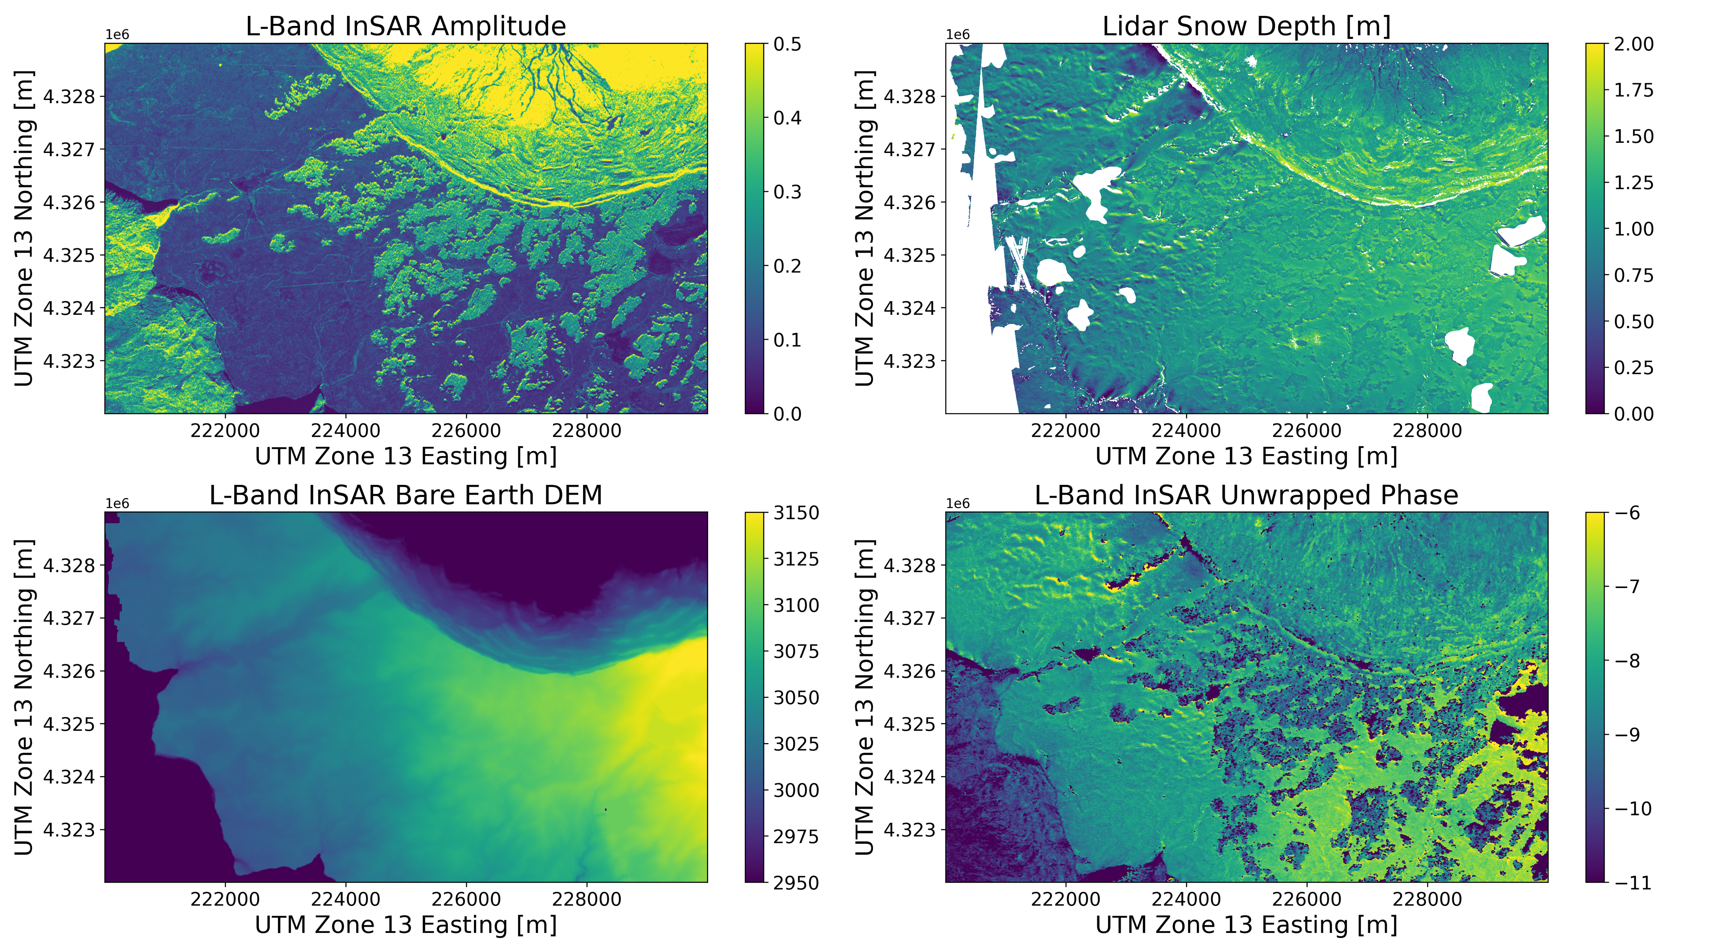
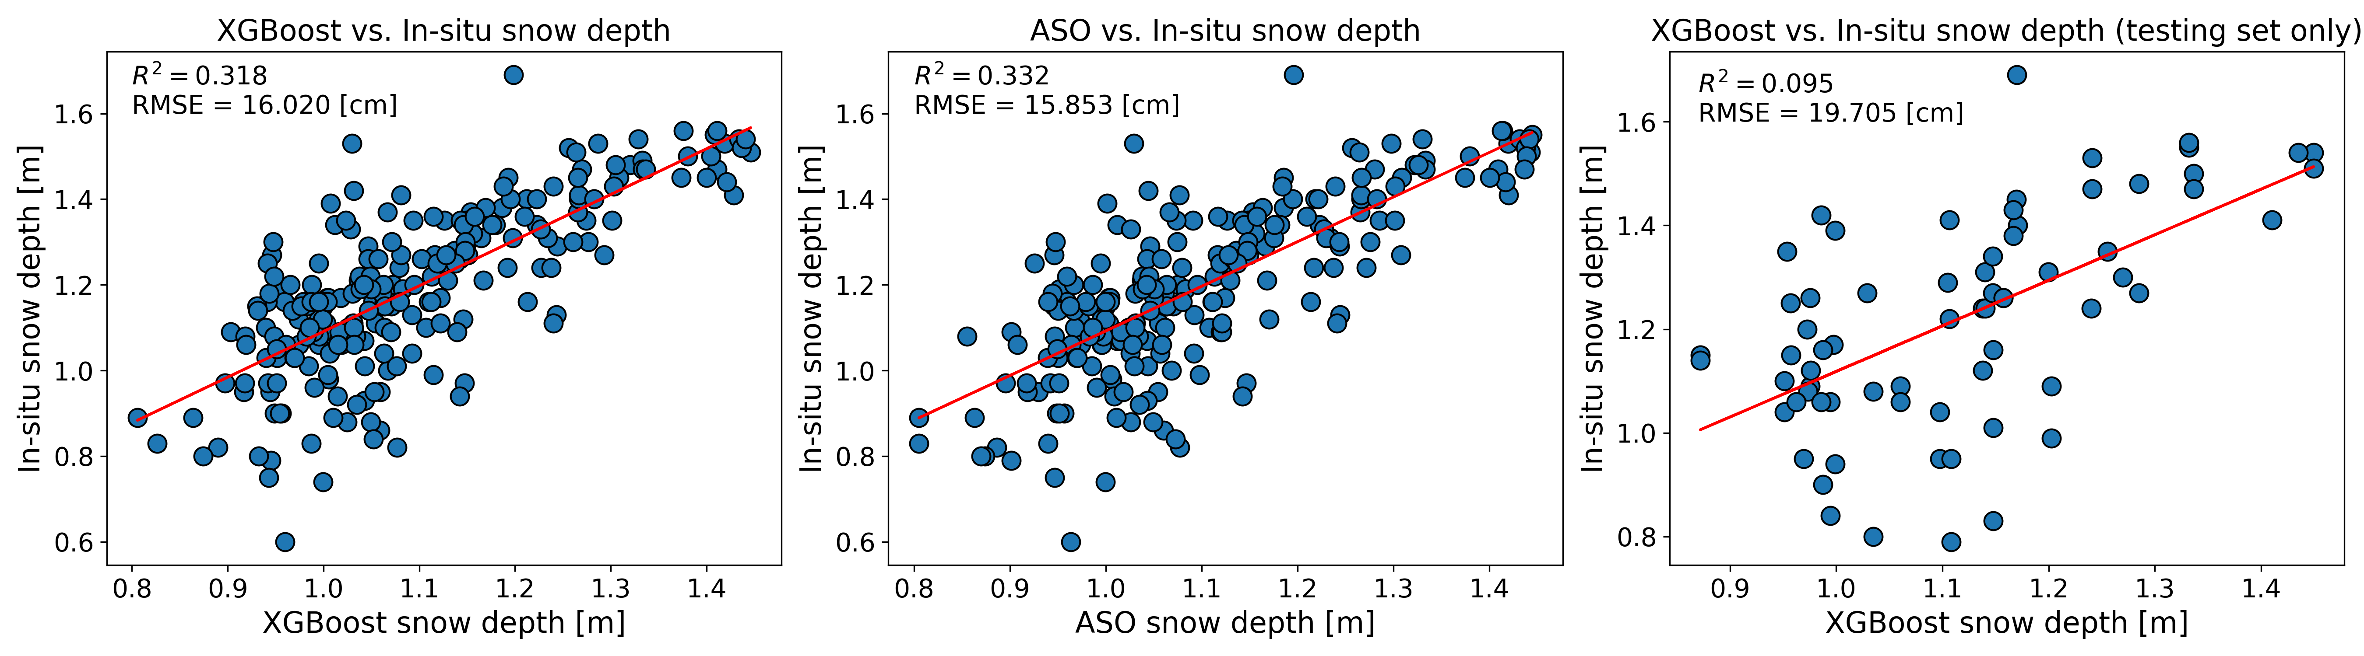
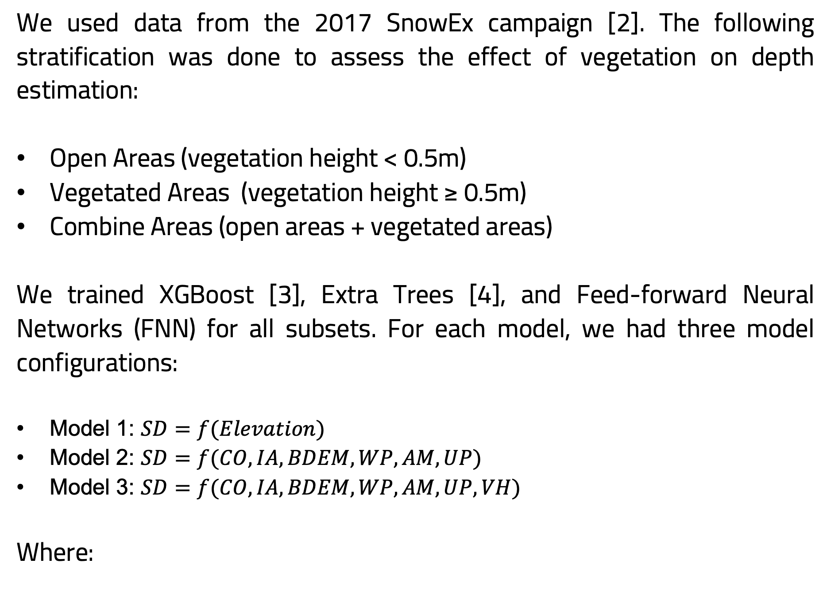
C51G-1020: Harnessing L-Band InSAR and Lidar Data Through Machine Learning
for Accurate Snow Depth Estimation in Grand Mesa, Colorado
Ibrahim Alabi¹ Hans-Peter Marshall² Jodi Mead³ Ernesto Trujillo² Evi Ofekeze¹
¹Computing PhD, Data Science, Boise State University ²Department of Geosciences, Boise State University ³Department of Mathematics, Boise State University
Background
Methodology
RESULTS
Answer to Objectives
Reliable snow depth mapping is critical for water resource management and climate modeling. Existing spaceborne and airborne techniques face limitations from coarse resolution, high costs, sparse coverage, and weather dependence. Synthetic aperture radar (SAR) provides active microwave imaging that penetrates clouds. Interferometric SAR (InSAR) has been used to measure surface movement. Here, we assume no ground movement, but we use the delay in the snow signal to measure snow depth change as originally suggested by [1].
We apply machine learning to predict snow depth using L-band InSAR data from NASA JPL's UAVSAR sensor. This research explores the potential of this approach for global-scale snow monitoring in anticipation of the upcoming NASA-ISRO SAR (NISAR) mission.
Assumption: total snow depth before melt starts displays similar patterns to snow depth changes due to snow accumulation.
We used data from the 2017 SnowEx campaign [2]. The following stratification was done to assess the effect of vegetation on depth estimation:
Open Areas (vegetation height < 0.5m)
Vegetated Areas (vegetation height ≥ 0.5m)
Combine Areas (open areas + vegetated areas)
We trained XGBoost [3], Extra Trees [4], and Feed-forward Neural Networks (FNN) for all subsets. For each model, we had three model configurations:
Model 1: $SD=f(Elevation)$
Model 2: $SD=f(CO, IA, BDEM, WP, AM, UP)$
Model 3: $SD=f(CO, IA, BDEM, WP, AM, UP, VH)$
Where:
Models were evaluated using the 10% held-out testing set. The overall best model is XGBoost on the full dataset. The results are displayed below:
Model performance on the test set
Objective 1: We demonstrated the potential of L-band InSAR data for snow depth estimation. XGBoost on the full dataset (overall best model) achieved an RMSE of 9.28 cm on the testing set when compared with ASO lidar and 16.02 cm when validated on in-situ observations.
Objective 2: We have nearly equal performance in open and vegetated areas. This indicates that InSAR can be used to measure snow in the forest if coherence is maintained. However, snow in the canopy and wind can impact coherence in the forest.
Objective 3: Unwrapped phase, bare earth DEM, and amplitude were identified as the most influential features for the overall best model using SHAP and XGBoost’s gain importance.
Fig. 6: RMSE on the testing set.
CO: Coherence
IA: Incidence Angle
BDEM: Bare Earth DEM
WP: Wrapped Phase
AM: Amplitude
UP: Unwrapped Phase
VH: Vegetation Height
SD: Snow Depth
Figure 11 indicates a strong correlation between ASO depth and the model prediction.
Fig. 7: R² on the testing set.
Fig. 11: Hexbin of Observed vs
Predicted on the test set
from the overall best model.
Fig. 1: The large red rectangle outlines a 9.25 x 32 km target
area that was imaged by all airborne sensors [2].
In Figure 12, RMSE = 9.28 cm and R2 = 0.89.
Fig. 3: A flowchart illustrating the step-by-step methodology
of our model training.
Fig. 8: Mean Bias Error on the testing set.
Data
Feature Importance
Fig. 12: Histogram of residuals
on the test set from
the best model.
Fig. 2: Grand Mesa (study area) in winter.
Conclusion and Future Work
Objectives
This work is a proof of concept for using L-band InSAR data to estimate total snow depth, in preparation for NISAR mission. With sufficient training data, machine learning models can potentially capture the complex relationships between snow depth and its influencing factors, enabling accurate snow depth prediction. However, care will be needed when applying ML models outside of the conditions used for training. This limitation will be explored in future works.
Future work will explore model transferability and resolution-accuracy trade-off.
The objective of this work is divided into three broad aspects:
Explore the Effectiveness of L-band InSAR Data: Assess the capability of machine learning algorithms to accurately predict total snow depth using L-band InSAR data.
Analyze Vegetation Impact: Examine how vegetation affects the performance of these machine learning models.
Evaluate Feature Importance: Determine the relative influence of each input feature in estimating total snow depth.
Fig. 4: NASA JPL’s UAVSAR SnowEx sensor.
Image credit: NASA-JPL Website.
Fig. 9: Feature importance for the overall best model as computed by SHAP [4] (left)
and XGBoost’s gain (right).
Acknowledgements
In-situ Validation Results
We would like to express our gratitude to the NASA Terrestrial Hydrology Program and all participants of the SnowEx campaign for providing the Lidar and in-situ data.
We also thank Yunling Lou - the UAVSAR Project Manager at NASA JPL - for the UAVSAR data.
This work was partially funded by the U.S. Army Cold Regions Research and Engineering Laboratory (CRREL) under contract W913E523C0002.
References
Guneriussen, T., Hogda, K. A., Johnsen, H., & Lauknes, I. (2001). InSAR for estimation of changes in snow water equivalent of dry snow. IEEE Transactions on Geoscience and Remote Sensing, 39(10), 2101–2108.
Kim E, Gatebe C, Hall D, Newlin J, Misakonis A, Elder K, et al. OVERVIEW OF SNOWEX YEAR 1 ACTIVITIES NASA Goddard Space Flight Center , 2 USRA , 3 Aerospace Corp ., 4 ATA Aerospace , 5 US Forest Service ,. Igarss. 2017;1388–90.
Chen T, Guestrin C. Xgboost: A scalable tree boosting system. In: Proceedings of the 22nd acm sigkdd international conference on knowledge discovery and data mining. 2016. p. 785–94.
Geurts, P., Ernst, D., & Wehenkel, L. (2006). Extremely randomized trees. Machine Learning, 63, 3–42.
Brucker L, Hiemstra C, Marshall H, Elder K. SnowEx17 Community Snow Depth Probe Measurements, Version 1 [Internet]. NASA National Snow and Ice Data Center Distributed Active Archive Center; 2018. Available from: https://nsidc.org/data/SNEX17_SD/versions/1.
Fig. 5: Variables in the dataset.
Fig. 10: Validation using the entire dataset (left), using ASO lidar snow depths (middle),
and the withheld testing set (right).
https://sites.google.com/boisestate.edu/cryogarswebsite/home
AGU Fall Meeting 2023 SFA, CA
ibrahimolalekana@u.boisestate.edu

